Slide 1
Retail Store Sales: Data Exploration & Visualisation
Presented by – Suu Myat noe wai
Tutor name – wong Kim siong
Date – 23 oct, 2026
https://github.com/Suu-mnw/Applied-Data-Science-1

Slide 2
Table of contents
Data Initial Inspection
Data Cleaning and Preparation
Descriptive statistics
Correlation & EDA depth
Visualisation
Trends analysis
Conclusion and Insights

Slide 3
Data Initial Inspection (original dataset)
Transaction dates
0 removed
Around 6,000
Data Types
12575 x 11
Exact Duplicate Rows
Missing counts
Original dataset
Row x columns
Discount Applied col
Outliers

Slide 4
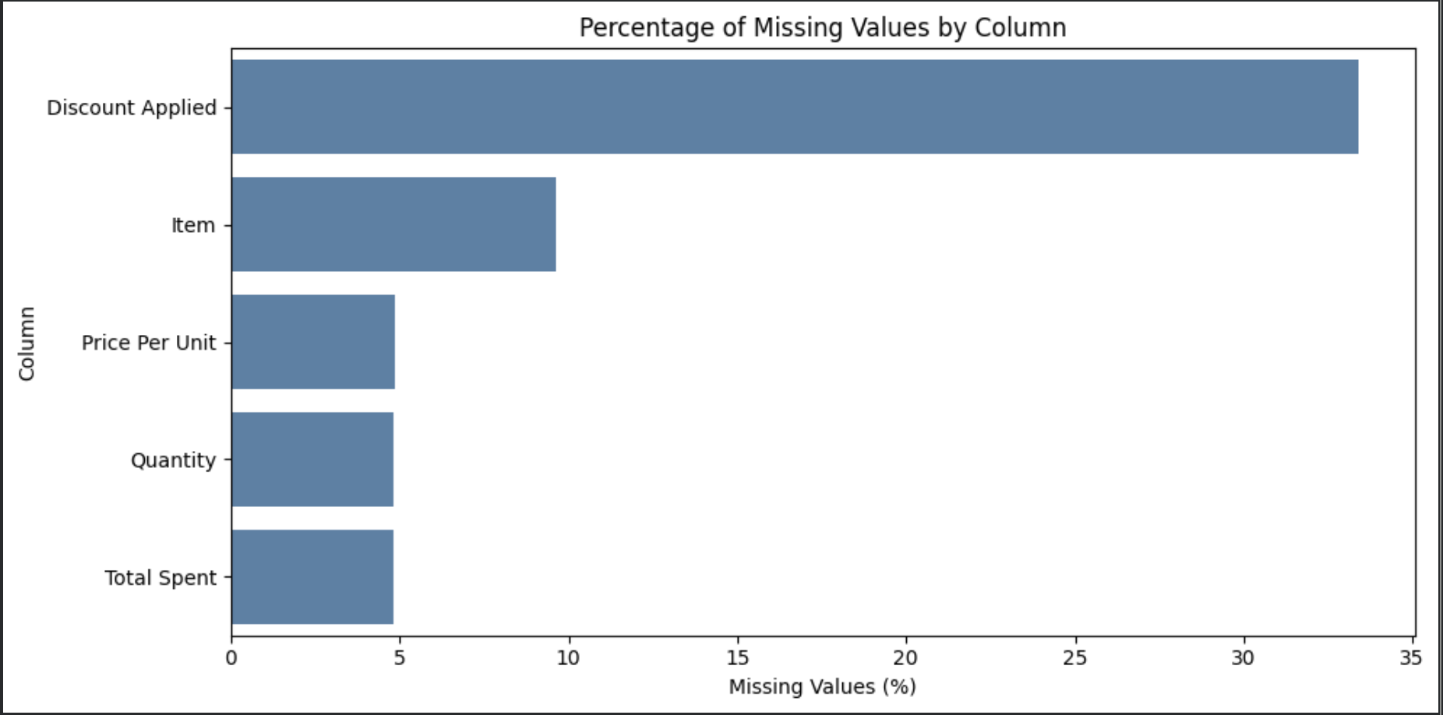
Data Cleaning and Preparation: Missing values
retained records to avoid unnecessary data loss
standardized the data and calculated missing totals where the required inputs were available
need further investigation depending on the analysis
Total Spent = Price Per Unit x Quantity

Slide 5
Data Cleaning and preparation
Standardize Texts : Trim spaces; turn empty strings into missing values.
Convert types : Convert price, quantity and spend to numeric; parse transaction dates.
Standardize discount : Map yes/no, true/false and 1/0 to Boolean values.
Check consistency : Remove exact duplicates; calculate missing totals where price and quantity exist.
Flag issues : Create flags for non-positive prices/quantities and possible total mismatches.

Slide 6
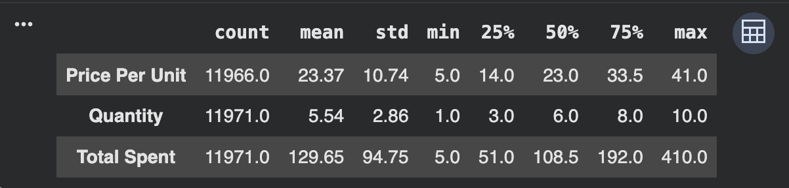
Descriptive Statistics
Mean spending (129.65) is higher than median spending (108.50)
consistent with distribution which some larger transactions pull the average upward.

Slide 7
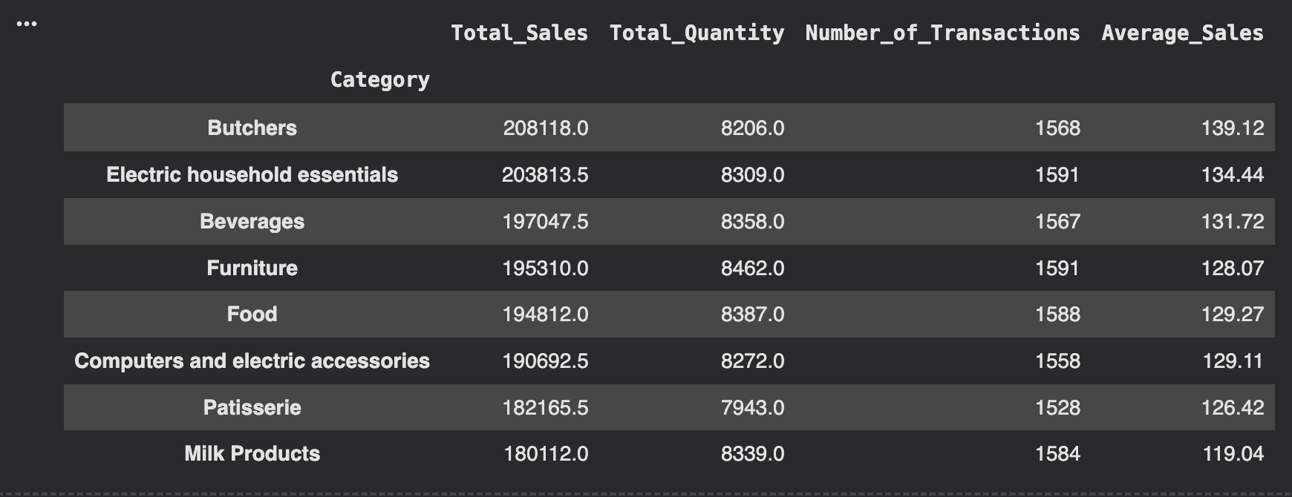
Summerize sales by Categories
describes category sales as balanced, with less than about a 15% gap between the highest and lowest categories.
highest-sales category was Butchers, with 208,118.00 in total sales.
Your lowest-sales category was Milk Products, with 180,112.00.

Slide 8
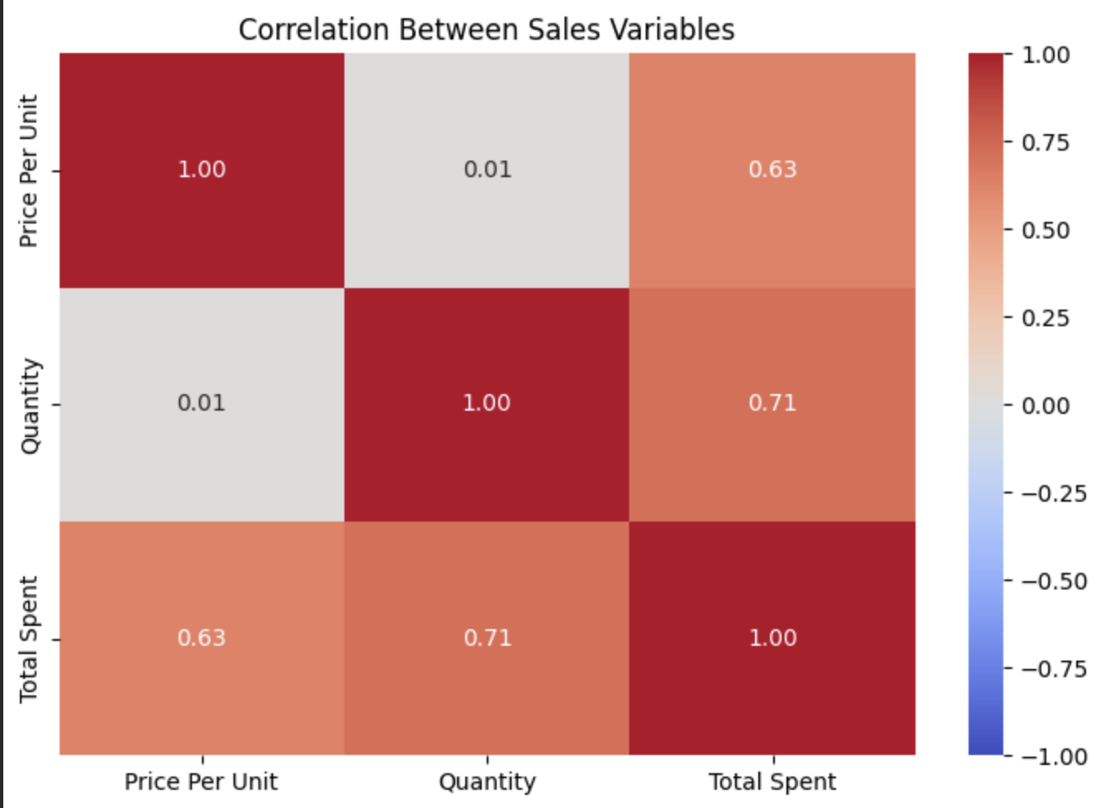
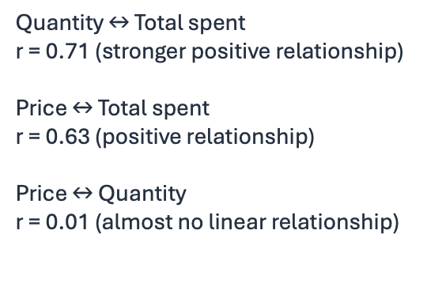
Correlation Analysis: Relationships Between Sales Variables
Key interpretation

Slide 9
Outliers
can help you identify unusual purchases, data-entry errors or transactions that warrant closer investigation
Interquartile range Method (IQR)
Two Thresholds:
Lower bound = Q1 – 1.5(IQR)
Upper bound = Q3 + 1.5(IQR)
IQR = Q3 – Q1
The IQR method flags 60 potential outliers in Total Spent, using an upper bound of 403.50.
Treat flagged values as records to review, not automatically as errors; the maximum reported spend is 410.

Slide 10
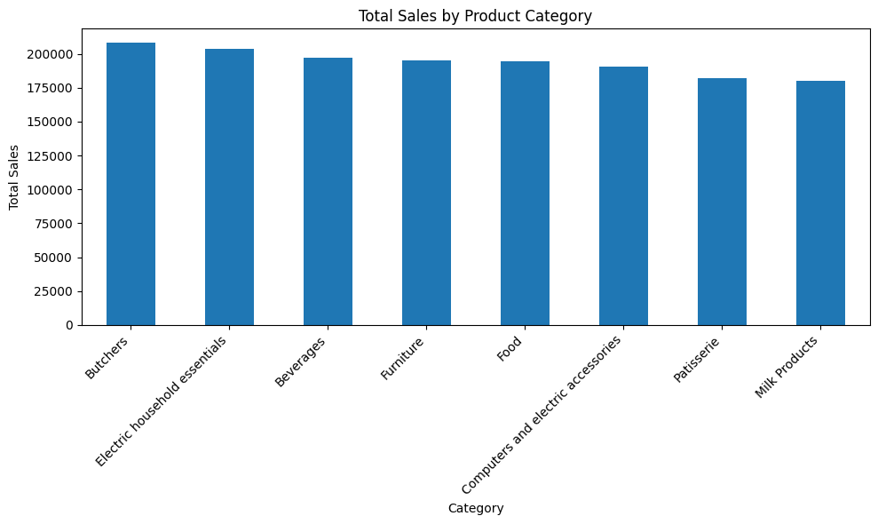
Total sales by Product Categories
Q: Which product categories generate the highest and lowest total sales, and how large are the differences between them?
Uses Bar Chart
Butcher is the highest at 208,118.00
Milk Products is the lowest at 180,112.00
Sales are fairly evenly distributed across the eight categories, with Butchers leading.

Slide 11
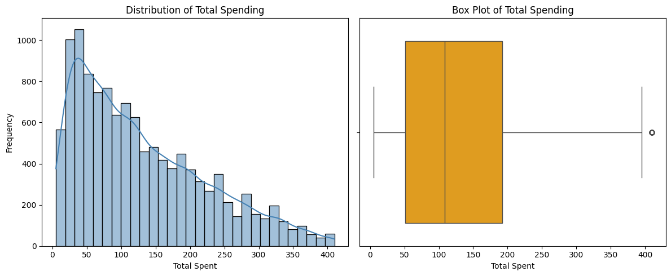
Distribution of Total Spending
Q: How is total spending distributed across transactions, and are there unusually high-spending transactions?
Histogram and boxplot
is right-skewed, meaning there are many smaller transactions and fewer large ones
Shows outlier in boxplot by IQR method
Most transactions are relatively modest, but a smaller number of high-spending transactions extend the upper tail.

Slide 12
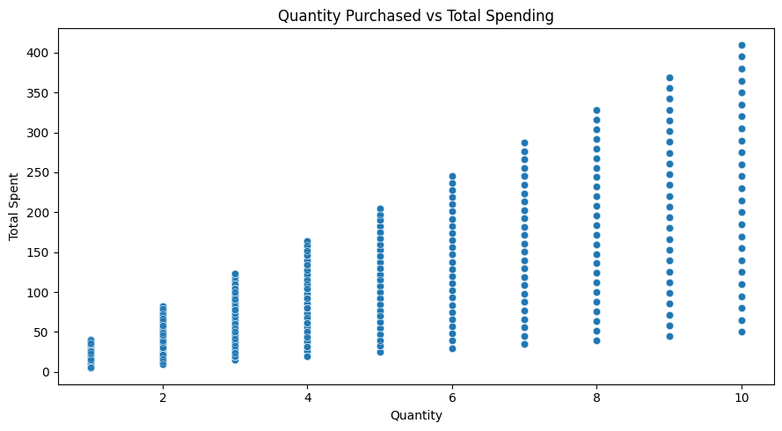
Quantity Purchased vs Total Spending
Q: What is the relationship between the quantity purchased and total transaction spending, and how much variation remains at each quantity?
Scatter plot
shows a positive trend.
Larger purchases generally have higher totals, but spending varies at each quantity because the unit prices differ.
Quantity matters, but it does not determine spending by itself.

Slide 13
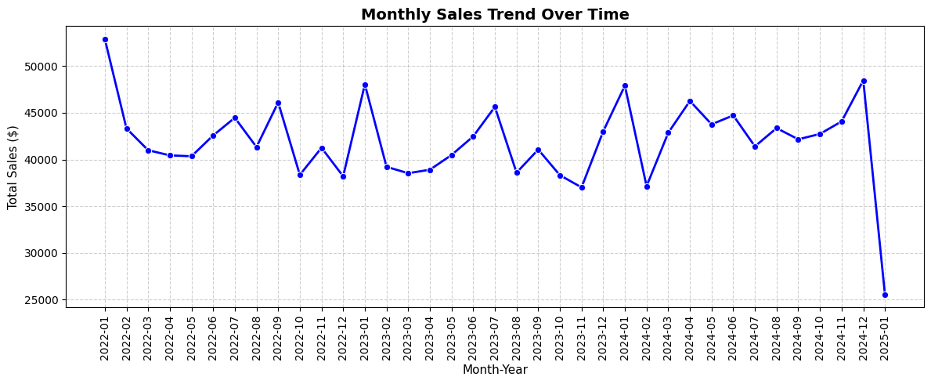
Monthly Sales Trend Over Time
Q: How do monthly total sales change over time, and is the sharp drop in January 2025 explained by incomplete data or a genuine sales change?
Line Chart
Describes fluctuations from January 2022 through January 2025, including a sharp fall at the final data point.
The final January 2025 decline needs investigation before it can be interpreted as a real business downturn.

Slide 14
Conclusion and Insights
Category performance: Butchers recorded the highest total sales (208,118.00), while Milk Products recorded the lowest (180,112.00).
Spending patterns: Mean spending (129.65) was higher than median spending (108.50), suggesting a right-skewed distribution.
Relationships: Quantity had a positive correlation with total spending (r=0.71)
Outliers: The IQR method flagged 60 potentially unusual spending records for further investigation.
If the business maintains sales in its stronger categories, attracts repeat customers, and increases spending per transaction, sales could grow.

Slide 15
Thank You
Any Questions?

